Slide 1
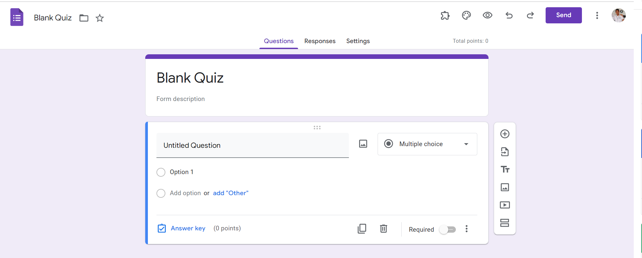
Identify root components of website below

Slide 2
Nav
Header
Container

Slide 3
Navigation
Nav-top
Nav-bottom

Slide 4
Nav-top
Div1
Div 2
Nav-left
Nav-right
Nav-bottom

Slide 5
Div1
Div2
icon
text
icon
icon
icon
icon
icon
icon
icon
button
icon
icon
Nav-left
Nav-right

